Slide 1
Thank you for joining!
The presentation will begin shortly.

Slide 2

How to Submit Questions During the Webinar
Zoom Housekeeping
Locate the ‘Q&A’ icon on the menu bar.
During the webinar, please submit questions via the 'Q&A' box.
You question will be responded to live by one of the presenters.

Slide 3
Leading the Way with Validated Data – Everything You Want to Know About the Data Aggregator Validation Program

Slide 4

NCQA Team
Data Aggregator Validation program team

Slide 5
General Program information
Audit and health plan-related information
Future of data aggregator validation
Getting Started
Notes:
Eboni

Slide 6
General Program Questions

Slide 7
Why was the Data Aggregator Validation
program created?
Notes:
Eboni

Slide 8

Health Care Data: An Explosion
Due to advancements in healthcare technology like the adoption of Electronic Health Records, patient technology, and greater interoperability of systems:
  Volume of health data is growing nearly 50% year over year.
  It’s not just the volume and velocity that is increasing – so, too, is the demand for accuracy.

Slide 9

Challenges of Data Exchange Today
  What It Means
The data you get may or may not be valid and accurate.
Additional work needs to be done to validate the data.
    Costs money to validate the data
    Lag time before you can use it
    Potentially inaccurate data
    Data in various formats
    Classified as non-standard supplemental data for HEDIS® reporting
HEDIS® is a registered trademark of the National Committee for Quality Assurance (NCQA).

Slide 10
What is NCQA’s Data Aggregator Validation program?
Notes:
Eboni

Slide 11
Program Concept
Clinical data is becoming more available every day at an increasing number of ingestion sites
Reduce the burden of
PSV for the plan-centric HEDIS audit
Aggregators help make that data accessible to plans by collecting it from an increasing number of sources
Data Aggregator
Validation program:
Validate data from ingestion to output from any eligible party – to use as standard supplemental data
Health plans need to use that data but are not assured it is always valid and accurate

Slide 12
Program Goals
Goal #1
Integrity
Goal #2
Conformity
Goal #3
Efficiency
Ensure that data integrity is maintained from ingestion at the primary source through transmission to vendors and health care organizations.
Ensure conformance with requirements for data output is accurately, consistently and appropriately adhered to.
Minimize the audit burden on vendors and health care organizations that receive and use data for reporting HEDIS measures

Slide 13
What are the benefits for NCQA’s Data Aggregator Validation program?
Notes:
Eboni

Slide 14
Program Benefits
Trust Data Accuracy
Showcase Safe Data Management
Evaluates the ingestion, transformation and output of clinical data to help ensure data integrity.
Organizations undergo a rigorous, end-to-end look at the quality and integrity of data and the procedures used to manage and safeguard it.
Improve Efficiencies
Support Contracting
Can be used as standard supplemental data in HEDIS reporting, eliminating the need for primary source verification (PSV) during the HEDIS audit process.
A validation from NCQA helps give your contracting partners more peace of mind and makes your data more valuable.
Serve as Industry Leader
Demonstrate to payers and partners that you have best-in-class data management practices and is taking steps to improve interoperability in the industry.

Slide 15
What are the validation activities?
Notes:
Eboni

Slide 16
Validation Activities
Three main activities to validate a data stream
Process, System, and Data (PSD) Standards Review
Output Data Integrity (ODI) 2.0: Conformance to CCD OR FHIR IG
Output Data Integrity (ODI) 3.0: Primary Source Verification (PSV)
Standards to assess accuracy, consistency, accessibility and timelines of the data.
HL7 C-CDA R2.1 September 2022 errata or US Core STU
(3.1.1 R4).
Reconciling data elements from the CCD or FHIR file with the primary data source (e.g., the EHR).
Notes:
Validating the data stream takes about 18 weeks.
The cohort lasts 22 weeks from kickoff to conclusion.

Slide 17
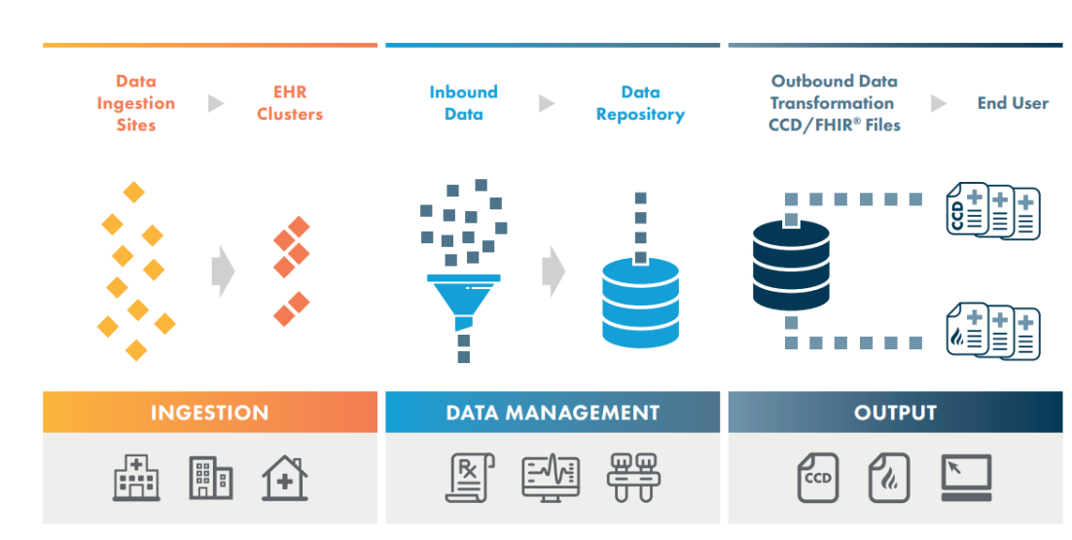
Program Structure
Notes:
Continuity of Care Documentation (CCD)
In use since the mid-2000s, was developed as a part of the Health Level Seven International (HL7) standards, specifically HL7 CDA (Clinical Document Architecture) standard.
Fast Healthcare Interoperability Resources (FHIR)
Introduced in 2011, and developed by HL7, is a more recent standard designed to improve healthcare data exchange and interoperability.
Several key policies and initiatives, including the 21st Century Cures Act, the ONC Cures Act Final Rule, and the CMS Interoperability and Patient Access Rule, actively endorse and promote the further adoption of FHIR® as the standard of choice for healthcare data exchange.

Slide 18
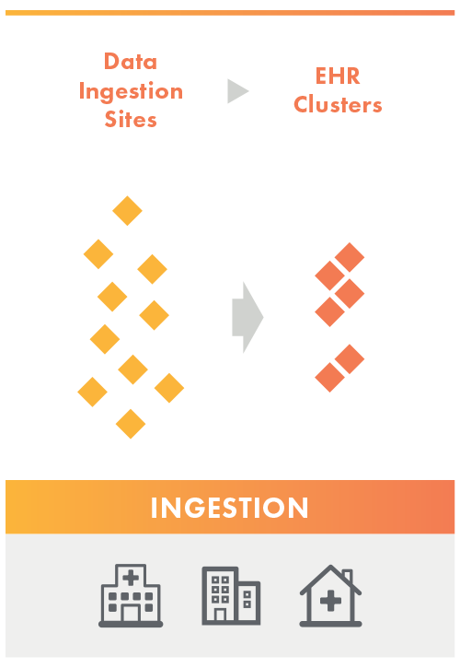
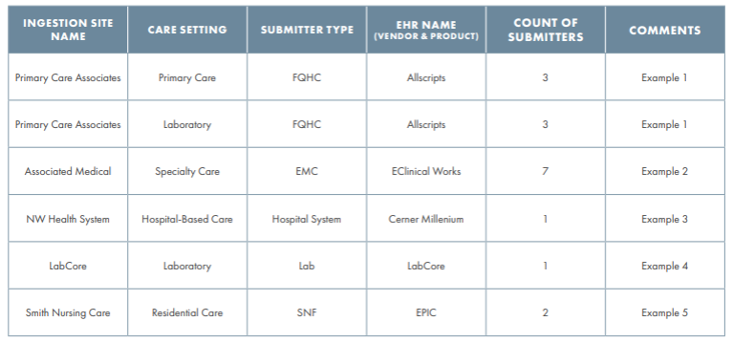
Step 1: Ingestion
The Responsible Party completes this task.
This step includes the Data Submission Log.

Slide 19
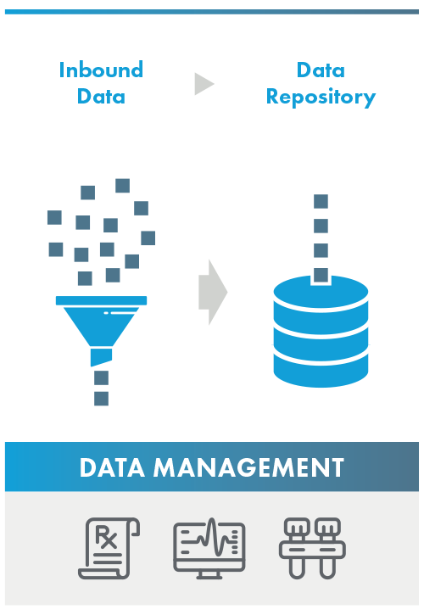
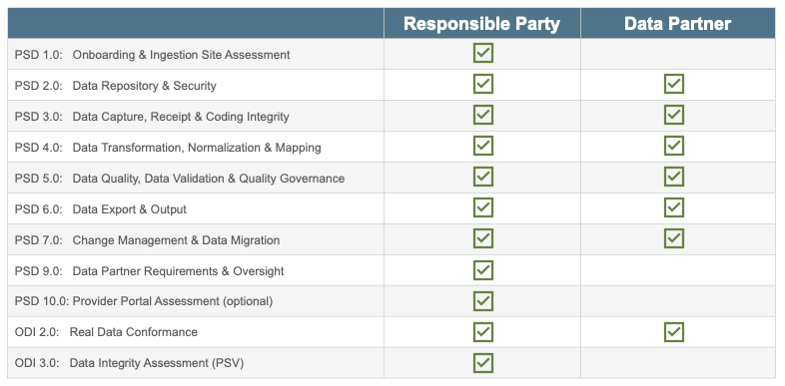
Step 2: The Standards
There are two sets of standards
    Process, System and Data (PSD) Standards
    Output Data Integrity (ODI) Standards
Data stream validation may be handled solely by a responsible party or in conjunction with a data partner.

Slide 20
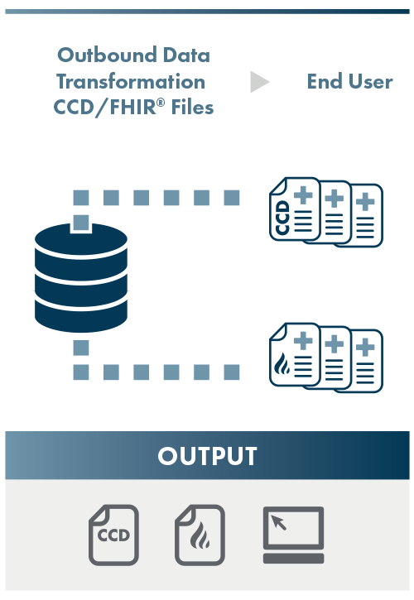
Step 3: Output
The Responsible Party is ultimately responsible for this task, however, the data partner may assist with ODI 2.0 Real Data Conformance
The validated output from Data Aggregator Validation entities is either:
  CCDs that comply with HL7 C-CDA R2.1 Implementation Guide
  FHIR output that comply with U.S. Core Implementation Guide STU3 (v3.1.1 R4)

Slide 21
What type of data is reviewed?
Notes:
Eboni

Slide 22
Output Review
Introduction to Critical Data Elements
The following are a few critical data elements that are a part of the output review.
Demographics | Dates | Vitals | Visit Events | Test Results | Other Data Elements
Patient Name | Admission Date | Blood Pressure | Problem list | Procedure interpretation | Allergies and Intolerances
Patient DOB | Discharge Date | Height | Encounter/Visit DX | Lab test and results | Social Hx
Facility Name/OID |  | Weight | Procedures | Imaging test and results | Immunizations
Race/Ethnicity |  | BMI |  | Eye care test and results | Functional status
 |  | Pain Assessment |  |  | Advance Directive
 |  |  |  |  | Medications
 |  |  |  |  | Questionnaires

Slide 23
What is the difference between
'Certified' and 'Validated'?
Notes:
Eboni

Slide 24
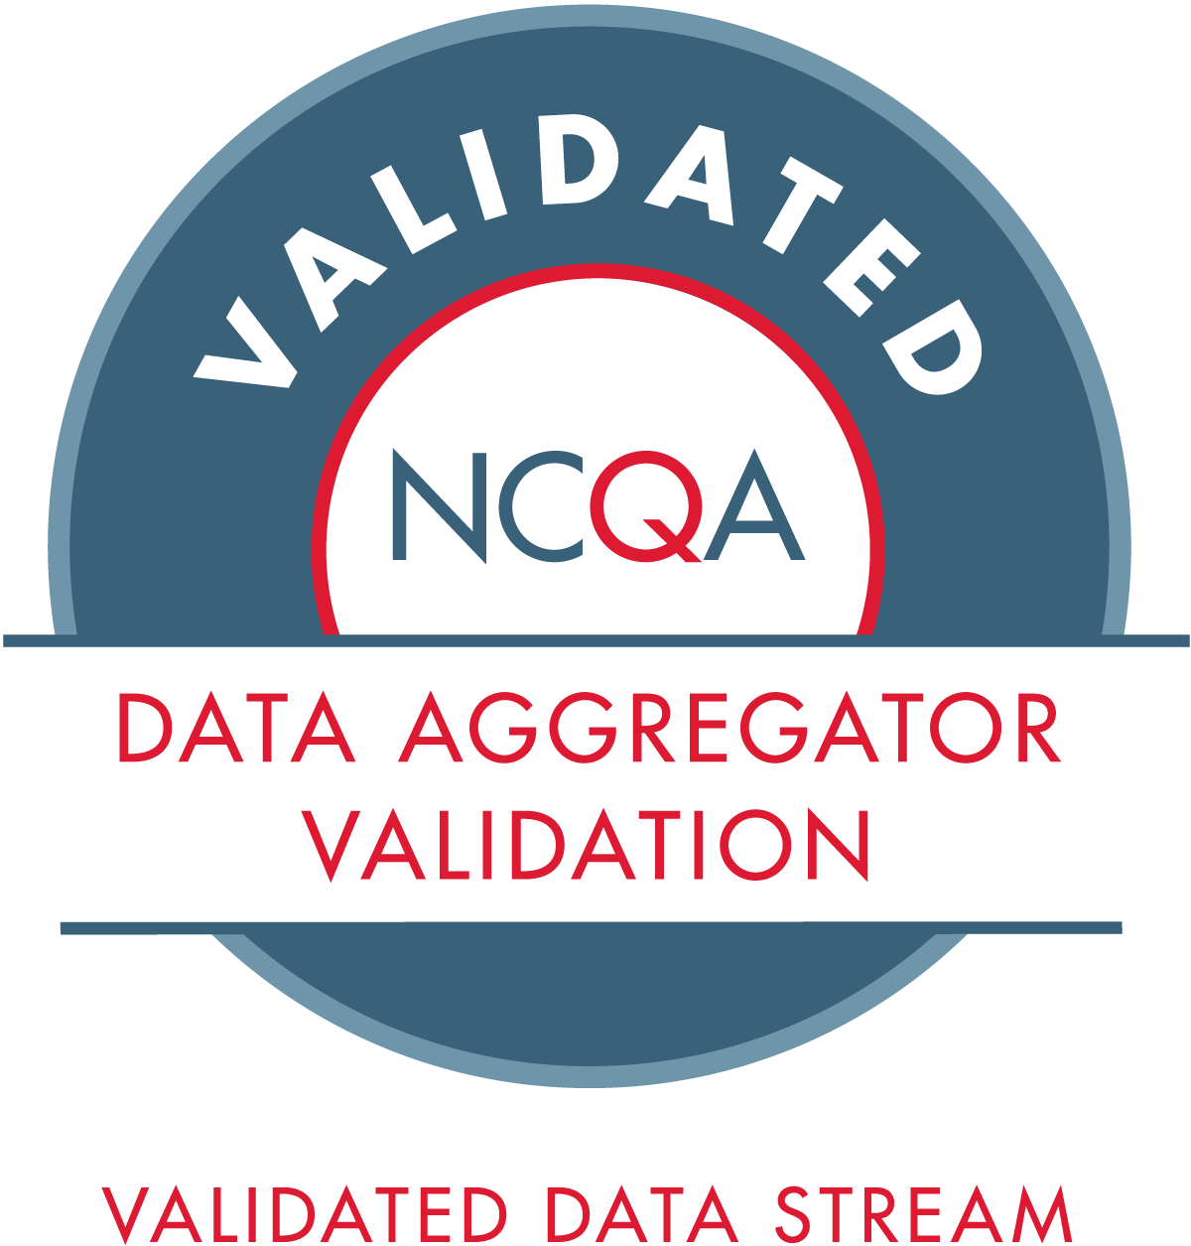

Available Designations
Two designations are awarded
Responsible Party
The org seeking validation of the data stream, contractually obligated to conduct primary source verification (PSV) and validation of the data stream
Responsible for all standards in data stream validation or may have 1+ data partners support their data stream validation.
Data Partner
An organization that does not have legal access to data to conduct PSV but may meet other Data Aggregator Validation program standards
May support responsible parties for validation of the data stream or may come through independently.

Slide 25
Requirements
Eligible organizations have:
A complete primary source verification process (RP only)
Legal rights and access to the primary source (RP only)
A data quality program
Ability to create, conform to, and transmit files in the prescribed format (CCD or FHIR)
Documented processes for clinical data:
    Receiving
    Transferring
    Storing
    Reconciling
    Transforming
    Exporting

Slide 26
Eligible Organizations
Health Information Exchanges (HIEs)
Health Information Networks (HINs)
Qualified Health Information Networks (QHINs)
Data aggregators
Health IT vendors
Health systems
Data warehouses
Health records (EHRs)
“For both sides this can reduce the man hours needed... [DAV with FHIR] is just the way it should run.
regional health data utility

Slide 27
How often do I need to re-validate or re-certify?
Notes:
Rebeccah

Slide 28

Re-validation Overview
The process takes about 22 weeks from start to finish.
Validation status is active for 12 or 24 months from the date of completion of the program.
After one successful initial validation and one subsequent re-validation are completed, participants can opt in to revalidating on a 24-month cycle.

Slide 29
Expected Timelines
Watch a first-time participant go through the program.
January 2024
Enrolls by December deadline
January 2025
At 12-month mark from enrollment, completes first revalidation cycle to ensure they continue to meet our rigorous standards.
January 2026
January 2028
At 24-month mark, completes revalidation cycle to ensure they continue to meet our rigorous standards.
Receives final report in June and is awarded validated data stream status for 12 months.
After one successful initial validation and one successful 12-month revalidation cycle, org is eligible to move to 24-month revalidation cycles.

Slide 30
Cohorts and Associated Status Dates
Cohort | 12-month Status Length | 24-month Status Length
January 2024 | 6/24 - 5/25 | 6/24 - 5/26
July 2024 | 12/24 - 11/25 | 12/24 - 11/26
January 2025 | 6/25 - 5/26 | 06/25 - 5/27
July 2025 | 12/25 - 11/26 | 12/25 - 11/27
January 2026 | 6/26 - 5/27 | 6/26 - 5/28
July 2026 | 12/26 - 11/27 | 12/26 - 11/28
Notes:
@Rebeccah to mention this is for their reference after the call when they download slides.

Slide 31
What happens if the Responsible Party is rapidly growing and would like to add more ingestion sites to the Data Submission Log mid-cohort?
Notes:
Rebeccah

Slide 32
PSV-only
The process takes about 22 weeks from start to finish.
Option for rapid PSV-only cycle.
Organization is held to the validation expiration date that aligns with the date the entire program was completed.
No changes can be made to the standards and processes that have already been validated.
Organizations who receive a "validated" status may pursue a PSV (ODI 2.0 and 3.0)-only validation cycle before completing a full revalidation.

Slide 33
How can my organization prepare for validation?
Notes:
Rebeccah

Slide 34
Purchase and review the program manual
Assess data quality as data are received
Inform partners of participation in the program and expectation (e.g., support PSV)
Plan accordingly. Timeline is tight, little to no wiggle room
Document data processing for sharing as part of audit

Slide 35

Team Roles and Responsibilities
NCQA recommends having a dedicated team to support the Data Aggregator Validation program activities
Project Manager – oversee team deliverables and program deadlines
Subject Matter Experts
  Responsible for PSV and PSD activities
    Quality Team
    IS/IT Team
    Clinical Team

Slide 36
Audit and Health Plan Questions

Slide 37
What are the audit requirements for using Data Aggregator Validation-validated data for standard supplemental data?
Notes:
Gill – this closes out the program process questions, here we are going to segue to health plan and auditor questions

Slide 38
Audit Requirements
Only Data Aggregator Validation-validated data streams, in the conformed CCD or FHIR format, are accepted as standard supplemental and therefore PSV is not performed.
Health Plans:
Submit Roadmap documentation by the January deadline (e.g., Section 5)
Adhere to all other supplemental source requirements (e.g. impact report)
any non-validated data streams received from Data Aggregator Validation entities need to be separated from validated streams, identified as non-validated for your auditor, and be evaluated as a non-standard source
Reminder
Auditors:
  Review Roadmap documentation from the organization receiving the data (e.g., health plan).
  Receive the final validation report from the Validated Responsible Party.
  Refer to NCQA’s Data Aggregator Validation directory to ensure the Responsible Party is approved to share data.

Slide 39

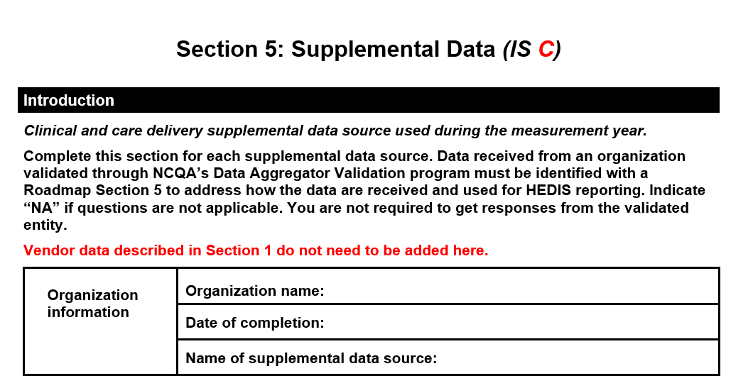
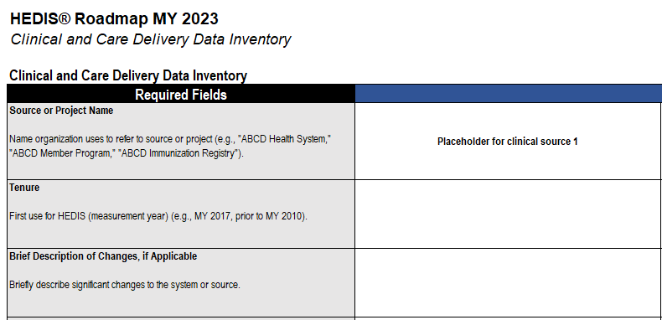
Roadmap Documentation
The Roadmap provides instructions addressing Data Aggregator Validation-approved data streams. Provide information on the source through these Roadmap documents by the January deadline.
Section 5
Clinical and Care Delivery Data Inventory
Other documentation requirements may also apply (e.g., impact reports, attachments). Please work with your auditor.

Slide 40
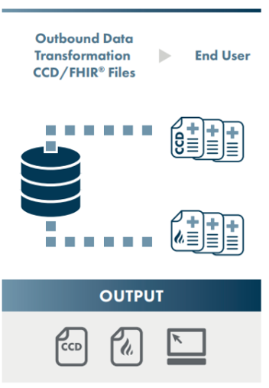
Output from the program includes validated CCDs or FHIR
The validated output from Data Aggregator Validation entities is either:
  CCDs that comply with HL7 C-CDA R2.1 Implementation Guide
  FHIR output that comply with U.S. Core Implementation Guide STU3 (v3.1.1 R4)
Data Processing
Processing the validated CCD is permitted, but the organization performing the processing must follow the 3 criteria below:
Processing the FHIR data is not permitted. Processing the FHIR data to another format compromises the status.
Document Mapping
Document extract-transform-load (ETL) processes
Maintain an original copy of the CCD

Slide 41
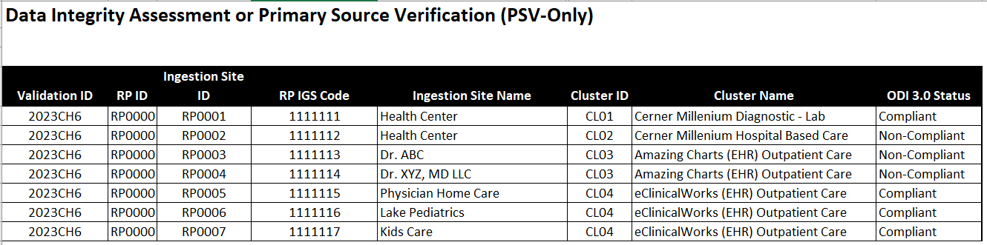
Validated Responsible Parties provide the final validation report

Slide 42
What is the volume of Data Aggregator Validation data in the health plan audit?
Notes:
Rebeccah

Slide 43
Share of Submissions and Plans Using Data Aggregator
Validation Data for HEDIS MY2022
​​ | Total
Submissions | 1,371/3,030 (45%)
Plans | 441/1,039 (42%)
Of 3,030 IDSS Submissions for HEDIS MY2022, 1,371 (45%) IDSS Submissions used some level of Data Aggregator Validation data.
Of 1,039 Health Plans HEDIS MY2022, 441 (42%) of health plans used some level of Data Aggregator Validation data for HEDIS MY2022.

Slide 44
How many organizations participate in NCQA’s Data Aggregator Validation program?
Notes:
Rebeccah

Slide 45





The program by the numbers
11
Certified or Seeking Certification Data Partners
27
Validated or Seeking Validation Data Streams
20
States Represented, and Growing
15+
Million Lives Covered
20,100
Data Sources Validated
As of February 2024

Slide 46
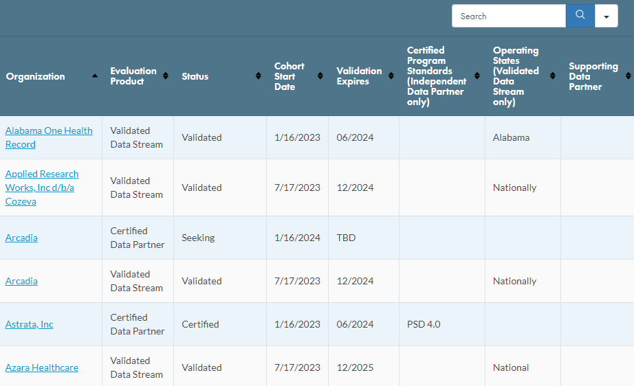
Directory of Entities

Slide 47
Program Roadmap

Slide 48
Have there been any recent changes to the program?
Notes:
Rebeccah

Slide 49
What’s New?
2023:
  Added new status option for 24-months for renewing organizations
  Expanded output file option for FHIR
  2024:
  Rapid PSV-only cycle option
  Added 3 new critical data elements for Primary Source Verification Review:
    Medications
    Advance Directives
    Questionnaire/Questionnaire Response
  Continued support of FHIR output option
Notes:
CM

Slide 50
What are use cases for the program?
Notes:
Rebeccah

Slide 51
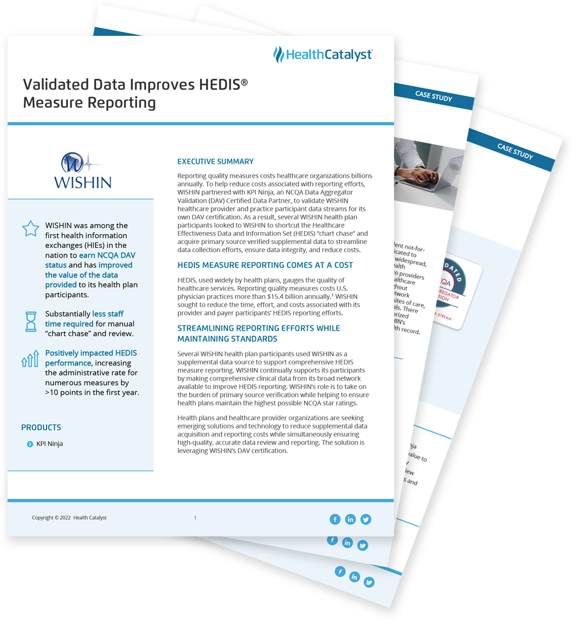

Use Cases & Case Studies
Standard supplemental data for HEDIS reporting
Efficiencies in care delivery and care coordination
Better utilization management
Care gap closures
Furthering Interoperability

Slide 52
Getting Started

Slide 53
How can my organization enroll?
Notes:
Rebeccah

Slide 54


Ways to Connect with NCQA
Complete the post-webinar Zoom survey requesting to speak with a program expert
Complete the contact form on the program page
Reach out to one of our program experts below
Dan Fisher
Account Executive
dfisher@ncqa.org
Bobby Minatra
Account Executive
bminatra@ncqa.org

Slide 55
Upcoming Cohorts and Application Deadlines
Aligned to support MY 2024 and MY 2025
July 2024
Application Deadline June 7, 2024
January 2025
Application Deadline December 6, 2024
July 2025
Application Deadline June 6, 2025

Slide 56
What resources are available to learn more
about the program?
Notes:
Rebeccah

Slide 57
Resources
Data Aggregator Validation Website
Client Directory
Program FAQs
2024 Data Aggregator Validation Manual

Slide 58
Still Have Questions?
Zoom Housekeeping
Locate the ‘Q&A’ icon on the menu bar.
During the webinar, please submit questions via the 'Q&A' box.
You question will be responded to live by one of the presenters.

