Slide 1
**WAITING ROOM SLIDE PLACEHOLDER**

Slide 2
Navigating Data Aggregator Validation: Choosing Between Responsible Party and Data Partner Roles
Notes:
Hello I’m Wendy Talbot, AVP Measure Collection and Audit and I have the pleasure of welcoming you to today’s webinar. We are so glad to have you with us to learn more about NCQA’s Data Aggregator Validation Program and choosing the right path between a Responsible Party and Data Partner role. As a reminder, Attendees will remain muted for the duration of the presentation. If you have questions, you would like the speakers to address, please input them into the “Q&A box”.
We will be sending an email to all registrants with a recording of today’s webinar later this week.
And with that We are delighted to introduce you to some of the names leading our DAV Operations team, starting Analyst Eboni Worley Measure Validation, and the individual kicking off our Webinar today and Assistant Director of Measure Collection and Audit DAV, Rebeccah Baer. Rebeccah go ahead and take it away.

Slide 3

NCQA Team
Data Aggregator Validation program team
Floating footnote placeholder box – copy & paste as needed

Slide 4
Program Overview, Goals and Benefits
Program Structure
The Standards
Responsible Party vs. Data Partner
Program Outcome

Slide 5
Data Aggregator Validation Program Overview, Goals and Benefits

Slide 6

The Journey
Pilot & Early Adopter
Launch
Program Roadmap
Discovery
Lessons Learned & Program Prep
Re-validation

Slide 7
Program Goals
Goal #1
Goal #2
Goal #3
Ensure that data integrity is maintained from ingestion at the primary source through transmission to vendors and health care organizations.
Ensure conformance with requirements for data output is accurately, consistently and appropriately adhered to.
Minimize the audit burden on vendors and health care organizations that receive and use data for reporting HEDIS measures

Slide 8
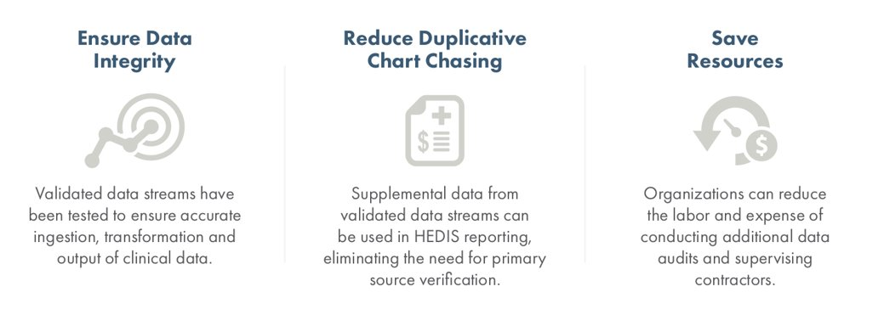
Benefits to Customers of DAV Responsible Parties

Slide 9
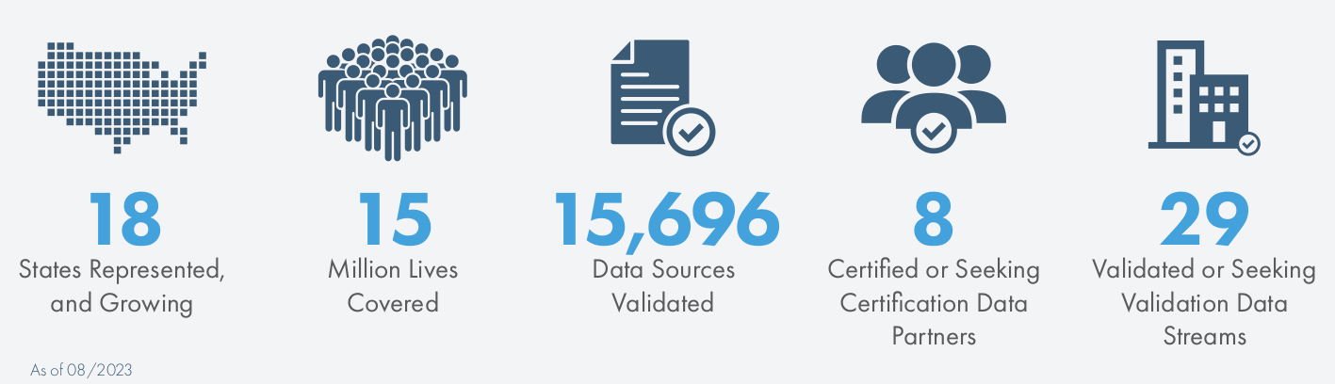
Data Aggregator Validation Program by the Numbers
Notes:
We’d love to include you in these numbers as we expand our footprint!

Slide 10
U.S. Map

Slide 11
Data Aggregator Validation Structure

Slide 12
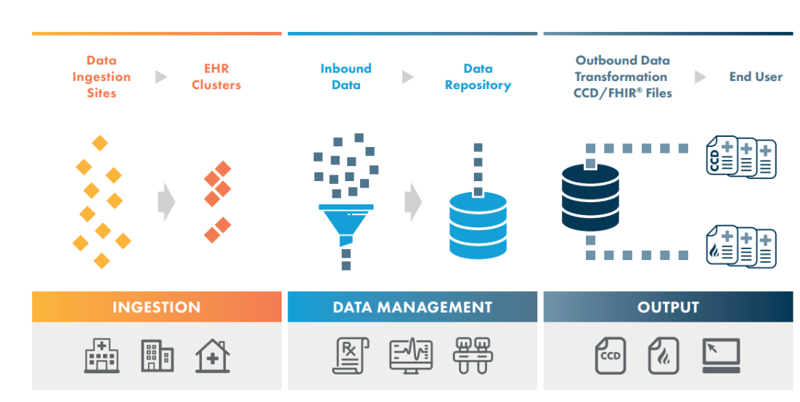
Program Structure

Slide 13
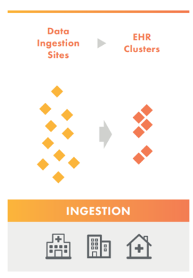
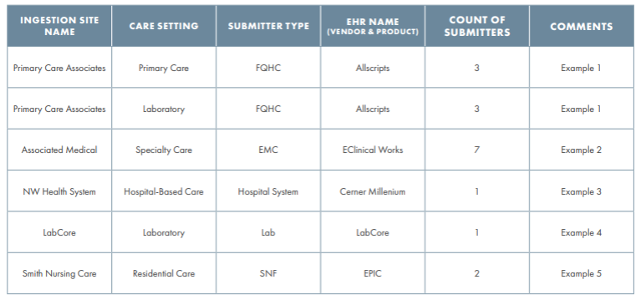
Step 1: Ingestion
The Responsible Party completes this task.
This step includes the Data Submission Log.

Slide 14
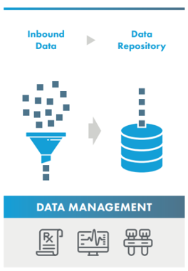
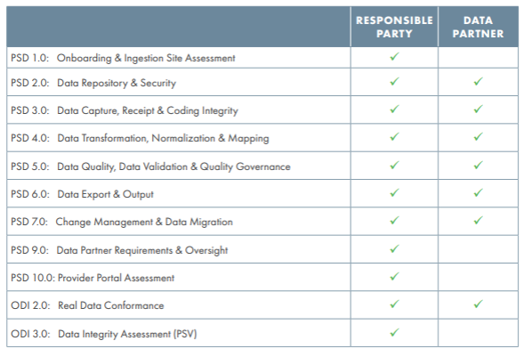
Step 2: The Standards
There are two sets of standards
  Process, System and Data (PSD) Standards
  Output Data Integrity (ODI) Standards
Data stream validation may be handled solely by a responsible party or in conjunction with a data partner.

Slide 15
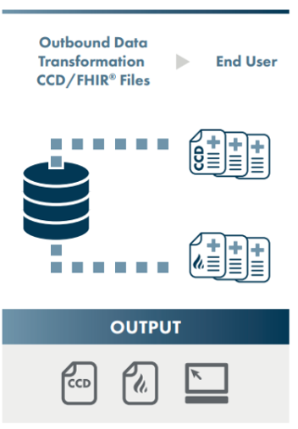
Step 3: Output
The Responsible Party is ultimately responsible for this task, however, the data partner may assist with ODI 2.0 Real Data Conformance
The validated output from DAV entities is either:
  CCDs that comply with HL7 C-CDA R2.1 Implementation Guide
  FHIR output that comply with U.S. Core Implementation Guide STU3 (v3.1.1 R4)

Slide 16
The Standards

Slide 17
Standards at a Glance
Process, System, Data Standards
Output Data Integrity Standards
PSD 1 | PSD 2 | PSD 3 | PSD 4 | PSD 5 | PSD 6 | PSD 7 | PSD 9 | PSD 10 (optional)
Onboarding | Data Repository | Data Capture | Data Transformations | Data Quality | Data Export | Changes & Migrations | Data Partner Requirements | Provider Portal
1.1 | 2.1 | 3.1 | 4.1 | 5.1 | 6.1 | 7.1 | 9.1 | 10.1
1.2 | 2.2 | 3.2 | 4.2 | 5.2 | 6.2 | 7.2 | 9.2 | 10.2
1.3 | 2.3 | 3.3 | 4.3 | 5.3 | 6.3 | 7.3 | 9.3 | 10.3
1.4 | 2.4 | 3.4 | 4.4 | 5.4 | 6.4 | 7.4 | 9.4 | 10.4
1.5 | 2.5 | 3.5 | 4.5 | 5.5 |  | 7.5 |  | 10.5
1.6 | 2.6 | 3.6 |  | 5.6 |  | 7.6
 |  | 3.7
ODI 2.0 | ODI 3.0
Conformance testing | Primary Source Verification

Slide 18
PSD 1
Onboarding & Ingestion Site Assessment
1.1- Documents of onboarding process submitted prior to receiving data.
1.2-Organizations maintains guides, etc., that define ingestion site participation.
1.3-Tracking of data issues and resolutions.
1.4- Tracking of participants and ingestion sites.
1.5-Evaluation of data structure and completeness of data integrity.
1.6-Does the organization perform PSV before accepting data?
Onboarding
Data Repository
Data Capture
Data Transformations
Data Quality
Data Export
Changes & Migrations
Data Partner Requirements
Provider Portal

Slide 19
PSD 2
Data Repository & Security
2.1-Data schema and architecture
2.2-Code requirements at the organization repository level
2.3-Data Dictionary
2.4- Documentation of repository access and maintenance .
2.5-Maintains documented procedures outlining access, permissions and consent.
2.6-Procedures for safeguarding sensitive information.
Onboarding
Data Repository
Data Capture
Data Transformations
Data Quality
Data Export
Changes & Migrations
Data Partner Requirements
Provider Portal

Slide 20
PSD 3
Data Capture, Receipt & Coding Integrity
3.1Inbound Data
3.2- Incoming data layout requirements
3.4- How are laboratory codes evaluated?
3.5- Data receipt requirements.
3.6- How do you monitor inbound data quality and data integrity?
3.7-Does the organization conduct PSV regularly?
3.3- Coding requirements for the ingestion site.
Onboarding
Data Repository
Data Capture
Data Transformations
Data Quality
Data Export
Changes & Migrations
Data Partner Requirements
Provider Portal

Slide 21
PSD 4
Data Transformation, Normalization & Mapping
4.1- Data transformation processes
4.2- Ingestion site data transformation accuracy.
4.3- Code descriptions and mapping.
4.4- Member attribution logic is documented and accurately applied.
4.5- Provider attribution logic is documented and accurately applied.
Onboarding
Data Repository
Data Capture
Data Transformations
Data Quality
Data Export
Changes & Migrations
Data Partner Requirements
Provider Portal

Slide 22
PSD 5
Data Quality, Data Validation & Quality Governance
5.1- Data governance ensures data integrity and accuracy.
5.2- Data quality assurance
5.3- Data integrity assessment.
5.4- Data integrity assessment includes PSV
5.5- Ongoing workflow evaluation.
5.6- Systematic review of data quality, integrity, and issue resolution.
Onboarding
Data Repository
Data Capture
Data Transformations
Data Quality
Data Export
Changes & Migrations
Data Partner Requirements
Provider Portal

Slide 23
PSD 6
Data Export & Output
6.1- Data export requirements.
6.2- Monitoring standards and output protocols.
6.3 - Data transfers to outbound recipients.
6.4- Hedis and AMP reporting is parsed to include approved ingestion sites.
Onboarding
Data Repository
Data Capture
Data Transformations
Data Quality
Data Export
Changes & Migrations
Data Partner Requirements
Provider Portal

Slide 24
PSD 7
Change management & Data Migration
7.1- Ingestion sites upgrades/changes are documented.
7.2- Data system migrations, mergers and repository changes are documented.
7.3 - Changes in sending or receiving data are evaluated reg
7.4- New ingestion sites are documented.
7.5- Changes in data content or format are identified and assessed.
7.6- The organization regularly monitors ingestion sites for process and system changes.
Onboarding
Data Repository
Data Capture
Data Transformations
Data Quality
Data Export
Changes & Migrations
Data Partner Requirements
Provider Portal

Slide 25
PSD 9
Data Partner Requirements & Oversight
This standard is Not Applicable, if Data Partner is not used.
9.1- RP has documented the DP's data stream usage.
9.2- RP had formal performance standards for data partners.
9.3- Data partners are monitored for adherence.
9.4- Communicated performance and PSV findings to data partner.
Onboarding
Data Repository
Data Capture
Data Quality
Data Export
Changes & Migrations
Data Partner Requirements
Provider Portal
Data Transformations

Slide 26
PSD 10
Provider Portal Assessment (optional)
10.1- The organization has documented processes for use of the portal.
10.2-The organization maintains an implementation guide, standards, and check list for portal use.
10.3- Maintains current list of users and processes to link data entered to user.
10.4- Evaluates content for data integrity assessments.
10.5- Performs PSV for data integrity.
Onboarding
Data Repository
Data Capture
Data Quality
Data Export
Changes & Migrations
Data Partner Requirements
Provider Portal
Data Transformations

Slide 27
ODI 2.0
Conformance Testing
Organization submits 1 patient file per cluster to NCQA for a conformance check.
  CCDs must conform to HL7 C-CDA R2.1.
  FHIR must conform to U.S. Core Implementation Guide STU3 (v3.1.1 R4).
  The file must pass ODI 2.0 before moving onto ODI 3.0.

Slide 28
ODI 3.0
Primary Source Verification
For each PSV case selected, the organization must submit the CCD XML or FHIR JSON file along with supporting primary source documentation.
Reconciling of data elements from the CCD or FHIR resource with the primary data source.
Ex: electronic health records would be considered a primary data source.

Slide 29
Responsible Party vs. Data Partner

Slide 30
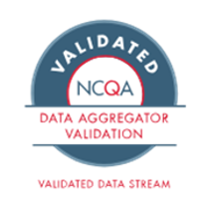
What is a Responsible Party?
RESPONSIBLE PARTY​
The org seeking validation of the data stream, contractually obligated to conduct primary source verification (PSV) and validation of the data stream ​
Responsible for all standards in data stream validation or may have 1+ data partners support their data stream validation.
Floating footnote placeholder box – copy & paste as needed

Slide 31
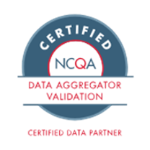
What is a Data Partner?
DATA PARTNER
An organization that does not have legal access to data to conduct PSV but may meet other Data Aggregator Validation program standards
May support responsible parties for validation of the data stream.
Floating footnote placeholder box – copy & paste as needed

Slide 32
Program Responsibilities
Responsible Party Program Tasks
Complete the Validation Assessment Tool (VAT)
  NOTE: required to be assessed on Process, System, Data (PSD) 1-7 at a minimum
Complete a 1-2 day virtual site review with the validator
Complete the Data Submission Log (DSL)
Submit Cases for Output Data Integrity (ODI) 2.0 Real Data Conformance
Submit Cases for ODI 3.0 Primary Source Validation (PSV)
Data Partner Program Tasks
Complete the Validation Assessment Tool (VAT)
  NOTE: Not required to complete every program standard
Complete a 1-2 day virtual site review with the validator

Slide 33
Responsible Party or Data Partner Poll
Q &A
Scenario 1: HIE X is seeking validation of the data stream and is legally able to conduct primary source verification (PSV). Which program role fits them best?
Scenario 2: After reviewing the standards, HIE Y can support 1+ standards but does not have legal access to data for PSV. Which program role fits them best?
Scenario 3: HIE Z is unable to conduct PSV or meet DAV program standards. Which program role fits them best?
Choices 1-3
Responsible Party
Data Partner
Neither roles

Slide 34
Program Outcome

Slide 35
Outcomes for Responsible Party vs. Data Partner
Responsible Party
Data Partner
Final Report
PSV-findings Report
Validation Status
Validation Seal
Marketing Press Release Information Packet
Featured in the NCQA Data Aggregator Validation Directory
Featured in the NCQA Report Cards
Can share data from validated data streams with end users
Final Report
Certification Status
Certification Seal
Marketing Press Release Information Packet
Featured in the NCQA Data Aggregator Validation Directory
Featured in the NCQA Report Cards

Slide 36
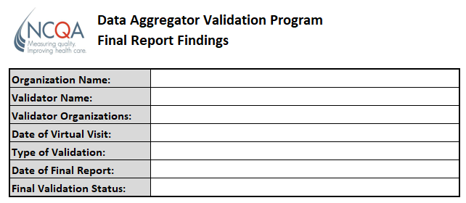
Final Report Findings
Report Contents
Organization Under Validation | Name
Validation Status | Final validation status
PSD Standards Compliance | Written assessment of organization performance on each PSD standard and its impact on data accuracy and integrity Recommendations Opportunities for improvement Corrective Action Plans
ODI 2.0 Results | Results of NCQA conformance checks
ODI 3.0 (PSV) Results | Results of PSV for each ingestion site Results of PSV for each provider portal Corrective Action Plans

Slide 37
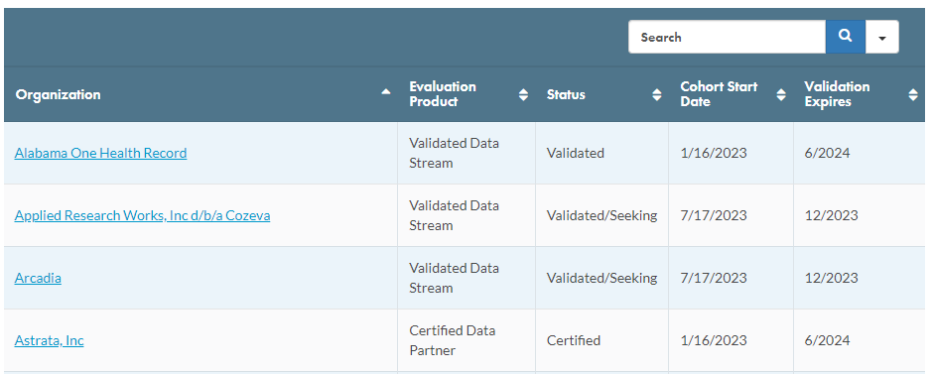
NCQA maintains a directory of DAV entities with current validation status

Slide 38
Helpful Resources
Visit our webpage
  https://www.ncqa.org/programs/data-and-information-technology/hit-and-data-certification/hedis-compliance-audit-certification/data-aggregator-validation/
Directory: Data Aggregator Validation
  https://www.ncqa.org/programs/data-and-information-technology/hit-and-data-certification/hedis-compliance-audit-certification/data-aggregator-validation/directory-data-aggregator-validation/
DAV Information for Health Plans
  https://www.ncqa.org/wp-content/uploads/2022/10/Health-Plan-DAV-Information_Sept2023_FINAL.pdf
Data Aggregator Validation Program Manual
  https://store.ncqa.org/hedis-quality-measurement/data-aggregator-validation.html?utm_source=SF&utm_medium=webinar&utm_campaign=Data+Aggregator+Validation&utm_id=January+2024&utm_term=20230815&utm_content=webinar

Slide 39
Which path is right for my organization?
Do you have legal access to the source of the data (i.e., EHR)?
Can you support Primary Source Verification?
Responsible Party
Yes
Yes
No
Can you support 1 or more Process, System, Data standards?
Do you work with any Responsible Partys?
Data Partner assisting a Responsible Party
Yes
Yes
No
No
Organization is not a fit
Standalone
Data Partner

