Slide 1
Digital Content Services Webinar Series
Episode #1: Discover Digital Measures and Roadmaps
Burke Burnett
Fern McCree

Slide 2

A Quick Word from Our Host…
The presentation will begin shortly.

Slide 3


Meet Today’s Speakers
Burke Burnett
Director,
Product Management
Fern McCree
Senior Research Associate,
Electronic Measurement Strategy

Slide 4
HOUSEKEEPING
MEASURE ROADMAP
DIGITAL CONTENT SERVICES
Q&A

Slide 5

Warm Up Question
How often do you work with HEDIS (the Health Effectiveness and Data Information Set)?
Choose one.
Daily
Weekly
Monthly
Occasionally
Rarely
Never
…What is HEDIS?

Slide 6

Poll Question #1
How do you or your clients use HEDIS quality measures today? Select all that apply.
To monitor quality & performance
To improve patient care & outcomes
To evaluate & compare provider performance
To provide care delivery feedback
To address care disparities
For value based contracting
For health plan reporting
All the above

Slide 7
Quality Ecosystem of the Past
High cost; manual; duplicative effort and infrastructure
Practice Guidelines
Fragmented, narrative, disconnected
Guidelines
Program Goals
Inefficiencies
$10Bs
PER YEAR
Retrospective; limited by data; “specs” only
Variation; inconsistent validation
Data Collection, Transfer, Aggregation
Measurement
Measure Specifications
Reports, CDS, Care Gaps, Analytics

Slide 8
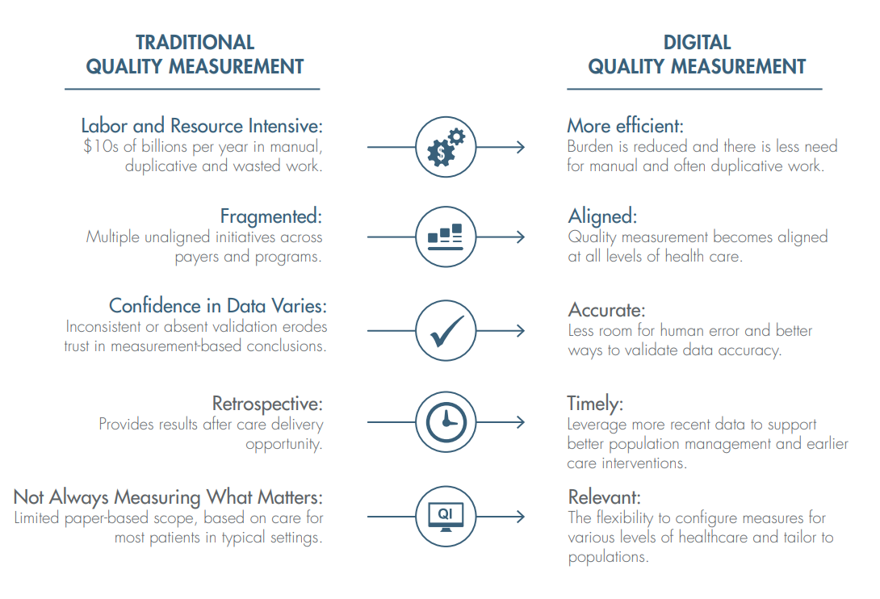
The Digital Quality Ecosystem
Traditional Quality
Ecosystem
Digital Quality
Ecosystem

Slide 9
Digital HEDIS Measurement Year 2023 Roster
(AAB) Avoidance of Antibiotic Treatment for Acute Bronchitis/Bronchiolitis (AAP) Adults’ Access to Preventive/Ambulatory Health Services 🅤 (ACP) Advance Care Planning (ADD-E) Follow-Up Care for Children Prescribed ADHD Medication (AHU) Acute Hospital Utilization (AIS-E) Adult Immunization Status (AMM) Antidepressant Medication Management (AMR) Asthma Medication Ratio 🅤 (APM-E) Metabolic Monitoring for Children and Adolescents on Antipsychotics (APP) Use of First-Line Psychosocial Care for Children and Adolescents on Antipsychotics 🅤 (ASF-E) Unhealthy Alcohol Use Screening and Follow-Up (AXR) Antibiotic Utilization for Respiratory Conditions (BCS-E) Breast Cancer Screening 🅢 (BPD) Blood Pressure Control for Patients With Diabetes (CBP) Controlling High Blood Pressure 🅢🅤🅗 (CCS-E) Cervical Cancer Screening (CHL) Chlamydia Screening in Women (CIS-E) Childhood Immunization Status (COA) Care for Older Adults 🅗🅢 (COL-E) Colorectal Cancer Screening 🅢 (COU) Risk of Continued Opioid Use | (CRE) Cardiac Rehabilitation (CWP) Appropriate Testing for Pharyngitis (DAE) Use of High-Risk Medications in Older Adults (DBO) Deprescribing of Benzodiazepines in Older Adults (DDE) Potentially Harmful Drug-Disease Interactions in Older Adults (DMH) Diagnosed Mental Health Disorders (DMS-E) Utilization of the PHQ-9 to Monitor Depression Symptoms for Adolescents and Adults (DRR-E) Depression Remission or Response for Adolescents and Adults (DSF-E) Depression Screening and Follow-Up for Adolescents and Adults (DSU) Diagnosed Substance Use Disorders (EDH) Emergency Department Visits for Hypoglycemia in Older Adults With Diabetes (EDU) Emergency Department Utilization (EED) Eye Exam for Patients With Diabetes 🅗🅢 (ENP) Enrollment by Product Line (FMC) Follow-Up After Emergency Department Visit for People With Multiple High-Risk Chronic Conditions (FUA) Follow-Up After Emergency Department Visit for Substance Use 🅤 (FUH) Follow-Up After Hospitalization for Mental Illness 🅤 (FUI) Follow-Up After High-Intensity Care for Substance Use Disorder | (FUM) Follow-Up After Emergency Department Visit for Mental Illness (HBD) Hemoglobin A1c Control for Patients With Diabetes 🅢🅤🅗 (HDO) Use of Opioids at High Dosage (HFS) Hospitalization Following Discharge From a Skilled Nursing Facility (HPC) Hospitalization for Potentially Preventable Complications (IET) Initiation and Engagement of Substance Use Disorder Treatment 🅤 (IMA-E) Immunizations for Adolescents (KED) Kidney Health Evaluation for Patients With Diabetes (LBP) Use of Imaging Studies for Low Back Pain (LDM) Language Diversity of Membership (LSC) Lead Screening in Children 🅗 (OED) Oral Evaluation, Dental Services (OMW) Osteoporosis Management in Women Who Had a Fracture 🅢 (OSW) Osteoporosis Screening in Older Women (PBH) Persistence of Beta-Blocker Treatment After a Heart Attack (PCE) Pharmacotherapy Management of COPD Exacerbation (PCR) Plan All-Cause Readmissions 🅤 (PDS-E) Postpartum Depression Screening and Follow-Up (PND-E) Prenatal Depression Screening and Follow-Up (POD) Pharmacotherapy for Opioid Use Disorder (PPC) Prenatal and Postpartum Care 🅗 | (PRS-E) Prenatal Immunization Status (PSA) Non-Recommended PSA-Based Screening in Older Men (RDM) Race/Ethnicity Diversity of Membership (SAA) Adherence to Antipsychotic Medications for Individuals With Schizophrenia (SMC) Cardiovascular Monitoring for People With Cardiovascular Disease and Schizophrenia (SMD) Diabetes Monitoring for People With Diabetes and Schizophrenia (SNS-E) Social Need Screening and Intervention (SPC) Statin Therapy for Patients With Cardiovascular Disease 🅢 (SPD) Statin Therapy for Patients With Diabetes (SSD) Diabetes Screening for People With Schizophrenia or Bipolar Disorder Who Are Using Antipsychotic Medications (TFC) Topical Fluoride for Children (TRC) Transitions of Care 🅗🅢 (UOP) Use of Opioids From Multiple Providers (URI) Appropriate Treatment for Upper Respiratory Infection (W30) Well-Child Visits in the First 30 Months of Life 🅤 (WCC) Weight Assessment and Counseling for Nutrition and Physical Activity for Children/Adolescents 🅗🅤 (WCV) Child and Adolescent Well-Care Visits 🅤
🅤 UNIVERSAL FOUNDATION
🅢 CMS STARS
🅗 HYBRID
Measures marked “E” are ECDS measures. All ECDS measures will be digitalized and cover components from traditional measure counterparts.

Slide 10
Bringing this back to today…

Slide 11

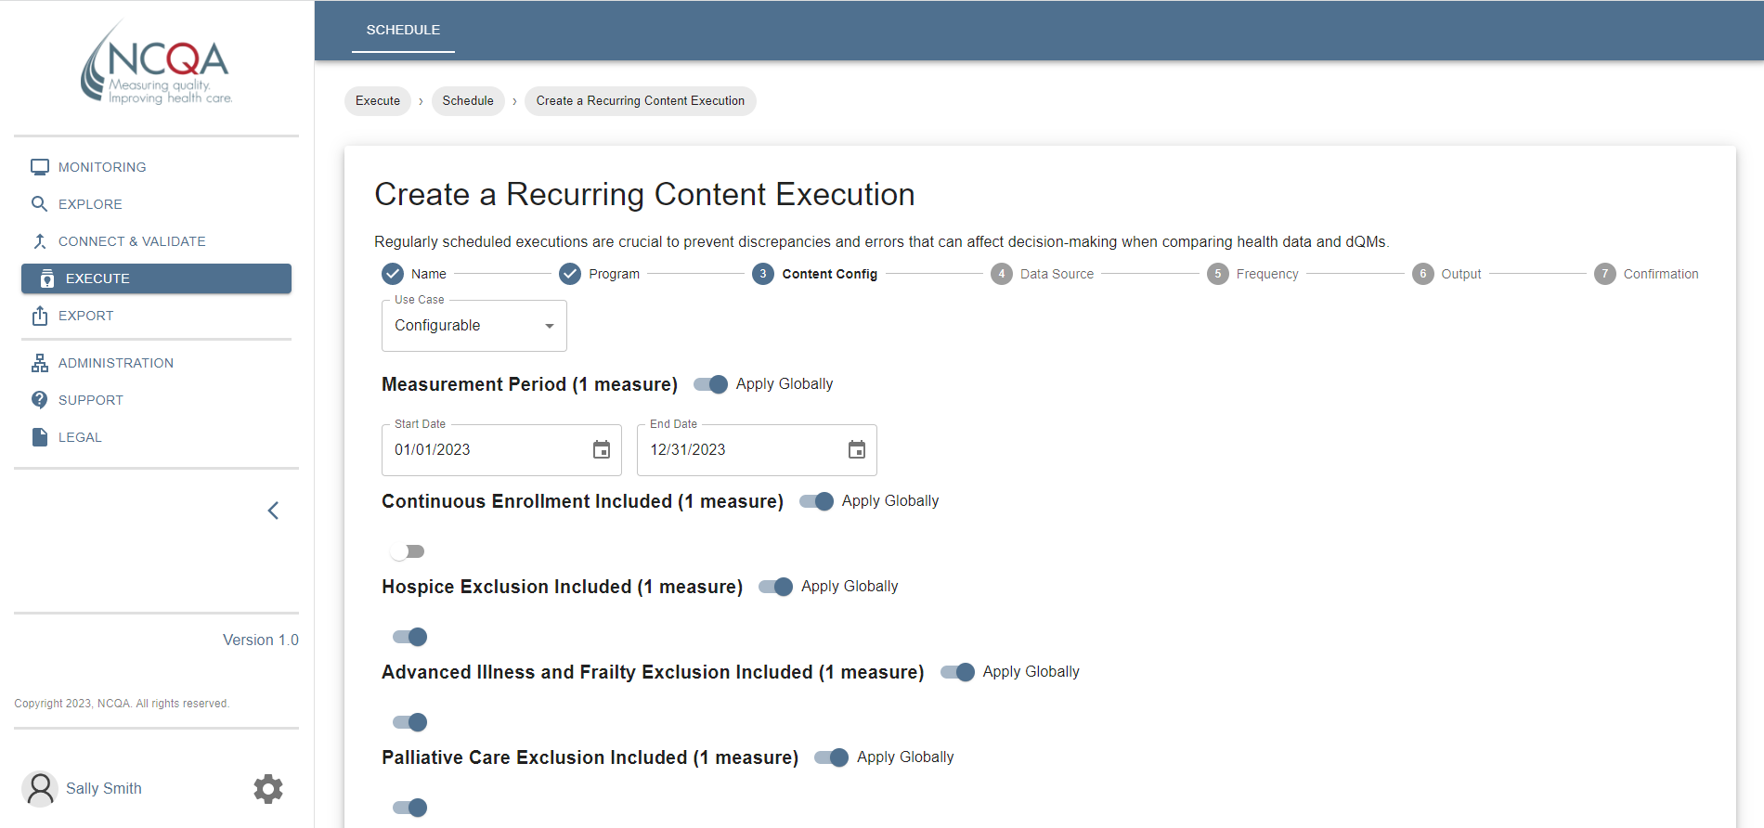

Introducing Digital Content Services
Out-of-the-box, configurable digital quality measures with a CQL engine
Brought to you by the most widely trusted evaluators of quality.
CQL = clinical quality language

Slide 12

Value Propositions
Digitalizing HEDIS
Reduce Cost
& Burden
Support Expanded Use Cases
Broader Access Across Levels of Accountability
Multiple Deployment Options
Updated, configurable digital measures mean less overhead spent on building and maintenance.
Easily integrate digital quality measures for a variety of use cases, including care cap closures, clinical decision support, and analytics.
Configurable content and connected technologies follow digital mandates suited to the industry’s digital quality needs.
Upgrade technologies strategically to align with your unique digital quality strategy.

Slide 13







Value Propositions
Joining the Early Adopter Program
Pioneer the Digital Shift
Clarity On Your Digital Progress
Access New HEDIS Content First
Develop Infrastructure
Streamline Workflows
Map Data for Quality
Position Your Success for Tomorrow

Slide 14
Use Cases Tomorrow
Throughout The Quality Workflow
Payment
Performance Measurement
Configurable, FHIR® CQL digital quality HEDIS measures that are expanded and executable
dQM processing software system to help you flow new measures through technologies and workflows
Reporting
Performance Management
General Release
Optimization
Quality Improvement

Slide 15
Use Cases Today
Quality Initiatives
Payment
Performance Measurement
Configurable, FHIR® CQL digital quality HEDIS measures that are expanded and executable
dQM processing software system to help you flow new measures through technologies and workflows
Reporting
Performance Management
Early Adopter
Program
Optimization
Quality Improvement

Slide 16
Receive, Understand, and Use Digital HEDIS Measures
Comply with industry mandates using a standards-driven solution.
Access a growing library of HEDIS content written in FHIR CQL.
Understand parameters, adjustments, and more with settings to configure HEDIS measurement calculations.
Connect and run scheduled calculations for insights on your proprietary FHIR data.
Investigate data errors or omissions with data profile validation tools.

Slide 17



Program Features
Perks for Early Adopter Participants
Dedicated Support
• Automated and configurable installation scripts
• Dedicated account manager
• Live training & support
Access NCQA’s
Digital Content Services
Promotional Support
• Recognition as a pioneer and digital measures trailblazer
• Case studies featuring your experience and participation
Streamline manual HEDIS calculations with an expanding suite of network-enabled HEDIS measures
Get easy-to-export results in person-level JSON files
Multiple installations per license
Peer Learning
• Industry insights and engagement with other early adopters
* Additional fees apply.

Slide 18
Formula for Success
Considerations for Early Adopter Participants
Must Be Cloud Enabled
Must Have FHIR Data
Provides services matched to our measures
Cloud types supported:
Azure • AWS • Google Cloud
Ability to provide data in accordance with NCQA’s FHIR Implementation Guidelines
Use the initial 14 measures now, or start installs this year to get a head start on the implementation curve.

Slide 19
Initial Set of Measures
Available for Measurement Year 2023 (MY 2023)
Prevention
BCS-E | Breast Cancer Screening
CCS-E | Cervical Cancer Screening
COL-E | Colorectal Cancer Screening
AIS-E | Adult Immunization Status
CIS-E | Childhood Immunization Status
IMA-E | Immunizations for Adolescents
Chronic Disease
DSF-E | Depression Screening and Follow-Up
APM-E | Metabolic Monitoring for Children and Adults
DRR-E | Depression Remission or Response for Adolescents and Adults
DMS-E | Utilization of the PHQ-9 to Monitor Depression Symptoms for Adolescents and Adults
Appropriateness of Care
AAB | Avoidance of Antibiotic Treatment for Acute Bronchitis/Bronchiolitis
CWP | Appropriate Testing for Pharyngitis
URI | Appropriate Treatment for Upper Respiratory Infection
UOP | Use of Opioids from Multiple Providers
*
*
*
*
*
Measures noted with an “E” are specified for Electronic Clinical Data Systems (ECDS) reporting. CCS is only available for ECDS reporting for MY 2023. * Measures included in the CMS’s Universal Foundation

Slide 20

Poll Question #2
When would your organization prefer to implement NCQA’s configurable digital HEDIS measures? Select one.
Yesterday
Within the next month
Fall 2023
Sometime in 2024
I couldn’t say

Slide 21
Requirements Checklist
Sample Checklist Items
Adheres to the NCQA FHIR Implementation Guide
Possesses either of the following cloud environments and cloud storage buckets to host our software:
  Amazon Web Services (AWS) / AWS 3
  Azure cloud / Azure Blob Storage
  Google Cloud Platform (GCP) / GCP Cloud Storage
Manages patient/member-level JSON FHIR outputs generated by our software
Integration of an OpenID identity management system
Security approval and sign off prior to software deployment
Expert resources assigned (ex. Dev Ops, Cloud engineering, or other meaningful equivalent or substitute) to conduct software deployment tasks and run system updates.

Slide 22
Make Headway on Digital Quality Mandates Today
Build
HEDIS
Expertise
Plan Your
Digital Strategy
Start Putting
HEDIS
to Work
Join the HEDIS Users Group
Enroll in HEDIS MY2024 Course
Enroll in NCQA's Digital Integration Strategies Course
Review the requirements and complete an application to Join the Digital Content Services Early Adopter Program

Slide 23

Come Meet Us In Person
Save $300 on Registration
Register by August 31 to save on individual registrations or bring your team for discounted group rates!
https://www.ncqasummit.com/
Notes:
Lets add links for Civitas and HIS
Tie it back to DAV by saying:
We have a lot of attendees on the call that are registered for upcoming events – Civitas in National Harbor next week and our own keystone event, Health Innovation Summit.
Our program experts and participants will be at both events to answer questions and speak with you about the program. Please check out the links in the chat to learn more about how to meet with us!

Slide 24
Q&A
Unanswered questions will be promptly addressed by our team of experts.
Notes:
We’ll open the floor for questions.

Slide 25
Thank you for joining us

